Slide 1
Detecting prostate cancer using deep learning convolution neural network with transfer learning approach
Sara Khosravi
2021

Slide 2

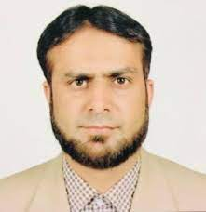
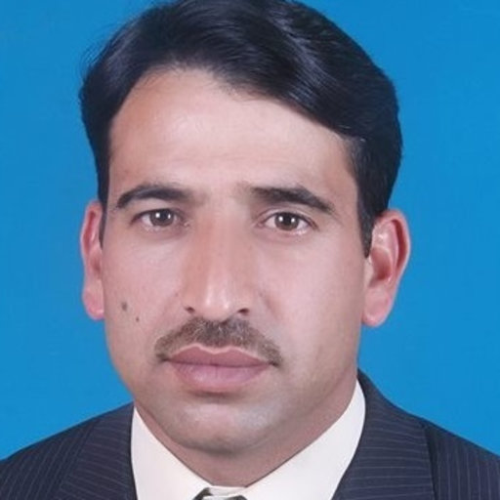

Overview
Published in 2020 in Springer Science and Business Media LLC
Cited 17 times
Adeel Ahmed Abbasi
Lal Hussain
Imtiaz Ahmed Awan
Imran Abbasi

Slide 3
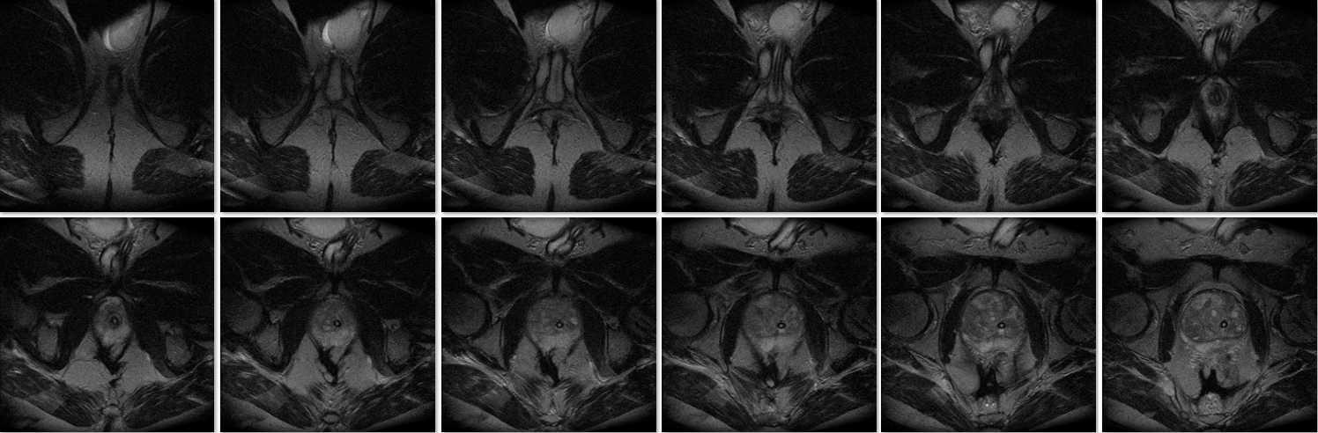
Dataset
Part of Prostate MRI database: publicly available, provided by the Harvard University
682 MRI slices: 482 from prostate patients, 200 from Brachytherapy (from 20 patients)
All images include: T1-weighted, diffusion-weighted, and dynamic contrast material-
enhanced imaging sequence
Fig1. MRI dataset

Slide 4
Background

Slide 5
Previous Methods
Based on machine learning techniques :low accuracy
To extract hidden features and have better performance: use deep learning approach
Improve robustness: use combination of features
The highest performance with ML: using SVM Gaussian that reached +97% accuracy

Slide 6
Methods
6

Slide 7

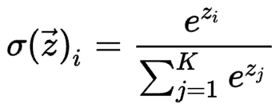
Deep Learning Approach
Convolutional neural networks
Downsampling: pooling
Fully connected layer
No dropout
Activation function: Softmax
Fig.2 : CNN overview

Slide 8
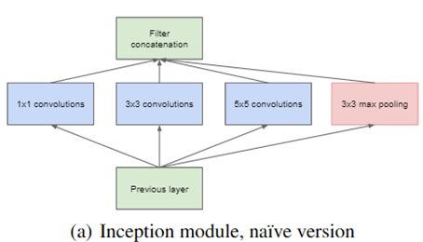
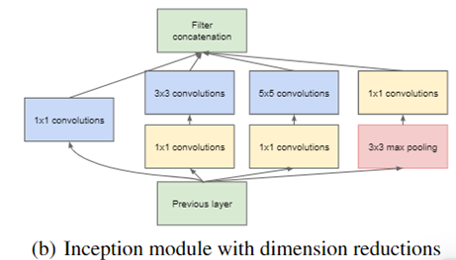
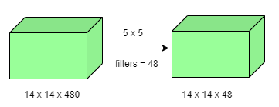
GoogleNet
Introduced in 2014 by Google
1x1 convolution
Average pooling
Inception module
Auxiliary classifier for training
Fig.3 : 1x1 convolution
Fig.4 : Inception

Slide 9
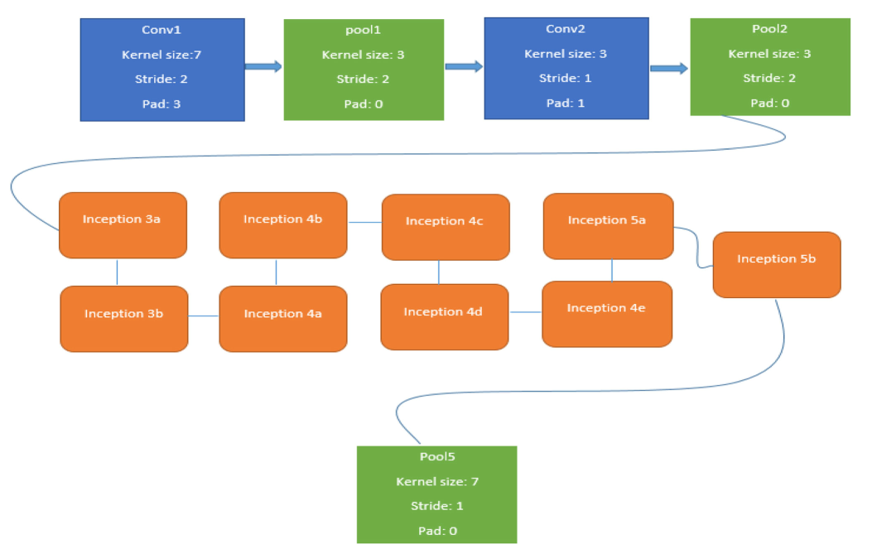
GoogleNet Architecture
Fig.5 : Last layers of the GoogleNet before ﬁnetuning

Slide 10
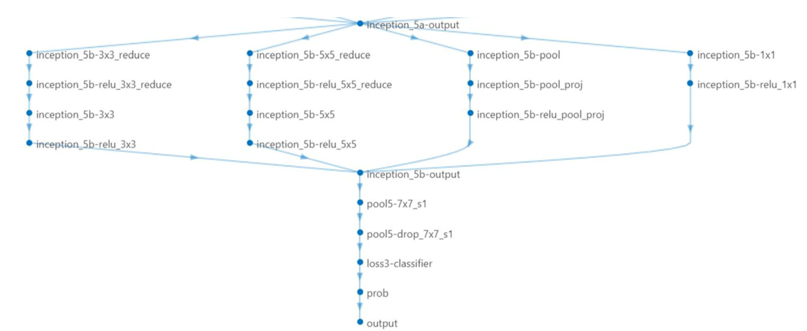
GoogleNet Last Layers
Fig.6 : Last layers of the GoogleNet before ﬁnetuning

Slide 11
Architecture: Modified GoogleNet
Replace last three layers with new layers to adapt new dataset to extract proper features
Fine-tune previous CNN (for 1000 classes) for 2 classes (Pca or not Pca)

Slide 12
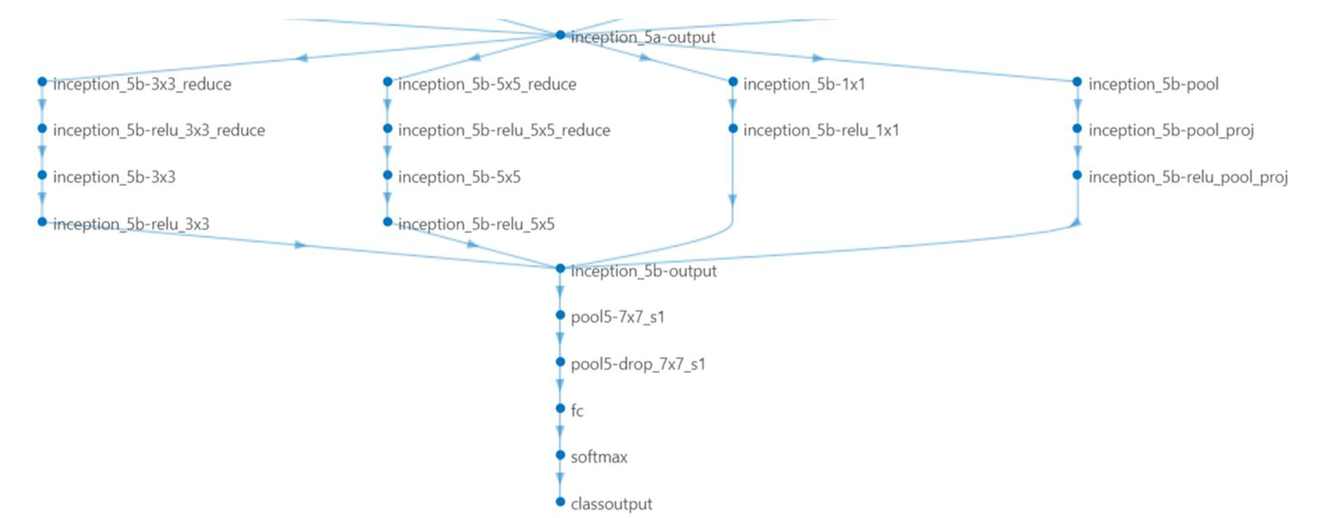
Modified GoogleNet Last Layers
Fig.7 : Last layers of the GoogleNet after ﬁnetuning

Slide 13
Evaluation

Slide 14

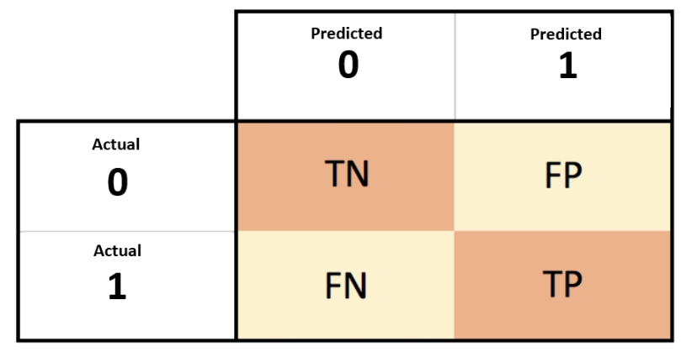




Metrics
Confusion matrix

Slide 15
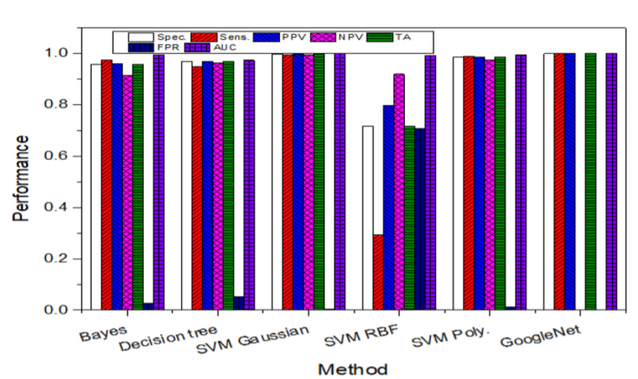
Results
Best model: Modified GoogleNet
High performance with any metrics in previous slide
Total accuracy: 100%
AUC: 1.00
Note: coded in Matlab
Fig.8 : Comparison of different methods

Slide 16
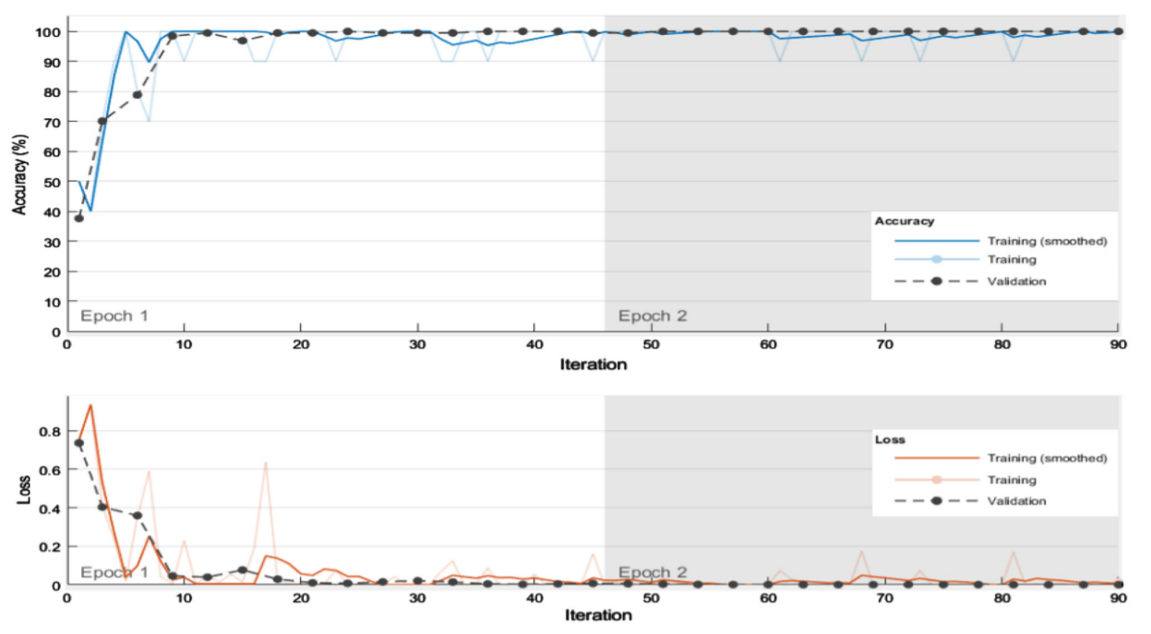
Results
My guess:
Overfitted
Specialized dataset
Fig.9 : Loss and accuracy of modified GoogleNet

Slide 17
Thanks For Your Attention
Any Questions?
Contact: srkhsrv21@gmail.com

